Slide 1
MAPPING PUBLIC RESTROOMS IN THE U.S.
BISWARAJ KAR
NORTHEASTERN UNIVERSITY
COLLEGE OF COMPUTER AND INFORMATION SCIENCES
GIS ADVANCED SPATIAL ANALYSIS (ENVR5260)

Slide 2
Project Overview
The project aims to map public restrooms and fee toilets across the city of Boston and other major cities and national parks in the United States. This would help tourists, elderly, LGBTQ+, women, senior-citizens and people with urinary and bladder problems to easily find facilities and plan their travel with confidence.
Unfortunately, in spite of having so much information online, currently there is no single resource in public which gives this information in a user-friendly mapped interface to locate restrooms across American cities. Some data does exist scattered among various websites, wikis and some city government websites, hence, being very difficult to find or interpret.
The project aims to list and map all the washroom data available in the public domain across many sources and help the public plan their travel or visits across the country, specifically patients with overactive bladder conditions.

Slide 3
GIS Prospects
Using GIS is a perfect solution to the issue as modern crowd-sourced GIS applications can consume user generated data and enhance the existing data on the fly. People can add new restrooms right onto a map using mobile applications and can also report non-functional or obsolete data. The online maps can be integrated into user-friendly GPS/map applications on phones to automatically detect the user’s location and show the nearest restroom.
The data can also be used for analysis by healthcare/government agencies for identification of strategic regions (with high population density or tourist places) with no or few restrooms to plan for building new restrooms.

Slide 4
Why is it important?
People vary widely in how often they need to use the bathroom. During the daytime, most go 1 to 6 hours between bathroom breaks. For those at the high end, the availability of a toilet is of little concern in the routine of daily life. Those at the other end of the spectrum hesitate to travel or participate in outdoor activities that put them out of range of toilet facilities.
The 'restroom challenged' occasionally have an urgent need to use a restroom less than an hour after departing. Shopping, visiting, or commuting to work is an ordeal. Unfortunately, other than a few indoor malls and some public transits systems, it’s very difficult to find public restrooms. Infact, respondents to many parks and Recreation Citizen Survey chose drinking fountains and public restrooms as the most important improvement that would help them use the Park and Trails.

Slide 5
The ‘restroom challenged’
Our society will freely discuss almost anything. However, mention of a spastic colon will quiet a room. On a more discrete level, one finds 'restroom duress' a broad concern, affecting many sections of the population such as:
Those suffering from Overactive Bladder, Interstitial Cystitis, Irritable Bowel Syndrome & Ulcerative Colitis.
Transgender persons and people who want to use the bathrooms that match their gender identity
The elderly (functional capacity is halved as we age) and middle age women
Patients suffering the diuretic effect of blood pressure medicine
Men suffering an enlarged prostate and those suffereing with bladder cancer
Patients on medications that act as bowel or bladder irritants
Pregnant women and women experiencing an irregular menses
Parents touring with young children and people suffering certain congenital defects
Those Victims of abdominal or nerve trauma and about 10 to 40% of Stroke victims
Ostomy pouches require prompt attention when at capacity
For those using a wheel chair, problems compound. They disproportionately suffer these conditions, while facing a greater challenge finding accessible facilities. Increasing the availability and distribution of public restrooms benefits everyone.

Slide 6
Studies and Research
National Association For Continence’s Urinary Incontinence Survey found that Overall, 26% of women ages 18 and older reported experiencing an involuntary loss of urine when coughing, sneezing, laughing or doing physical activity during the last 30 days.
The U.S. Department of Health and Human Services Deputy Assistant Secretary for
Women's Health, Dr. Wanda Jones has noted
research showing that obesity is an important
risk factor for incontinence among women.
The limited research available indicates that
Women afraid of bladder leakage are less
likely to report engaging in physical activities
that put them out of range of toilet facilities.
“When school children are not allowed sufficient restroom breaks, it impacts their physical health and reduces their classroom concentration. Many school teachers view toilet use as a privilege rather than a human need” - L.A. Couture, M.Ed, Author of Forced Retention of Bodily Waste: The Most Overlooked Form of Child Maltreatment.

Slide 7
Studies and Research..
Medical studies show the importance of regular urination, with women generally needing to void more frequently than men. Adverse health effects that may result from voluntary urinary retention include increased frequency of urinary tract infections (UTIs), which can lead to more serious infections and, in rare situations, renal damage. Medical evidence also shows that health problems, including constipation, abdominal pain, diverticuli, and hemorrhoids, can result if individuals delay defecation.
National Institutes of Health (NIH) Publication No. 95-2754, July 1995 29 CFR 1910.141(c)(1)(i)
The U.S. Occupational Safety & Health Administration provides the necessary regulations to ensure that people in the work place will not suffer the adverse health effects that can result if toilets are not available when needed. The agency mandated to protect the public's health outside of the work place, the Department of Health and Human Services, provides no similar regulation or even guidance.

Slide 8
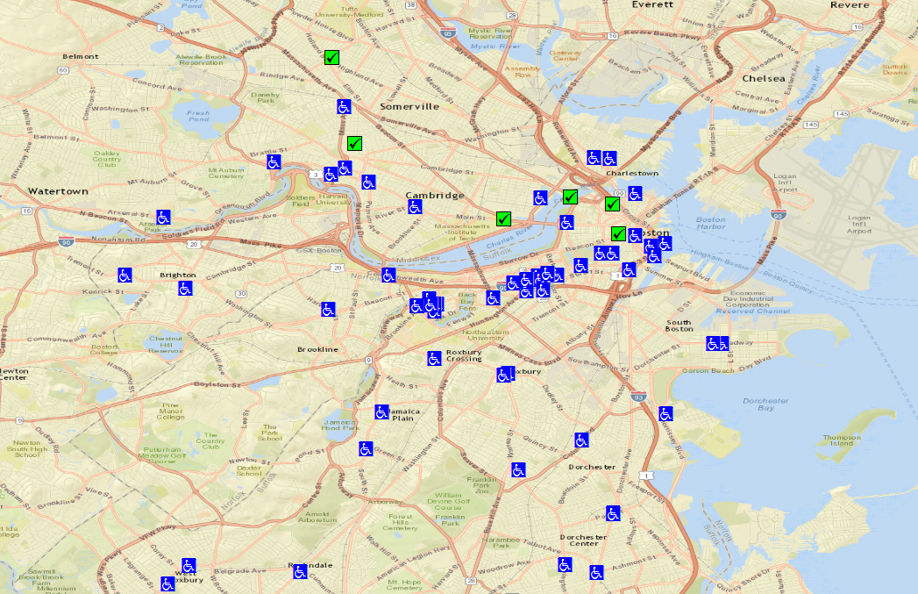
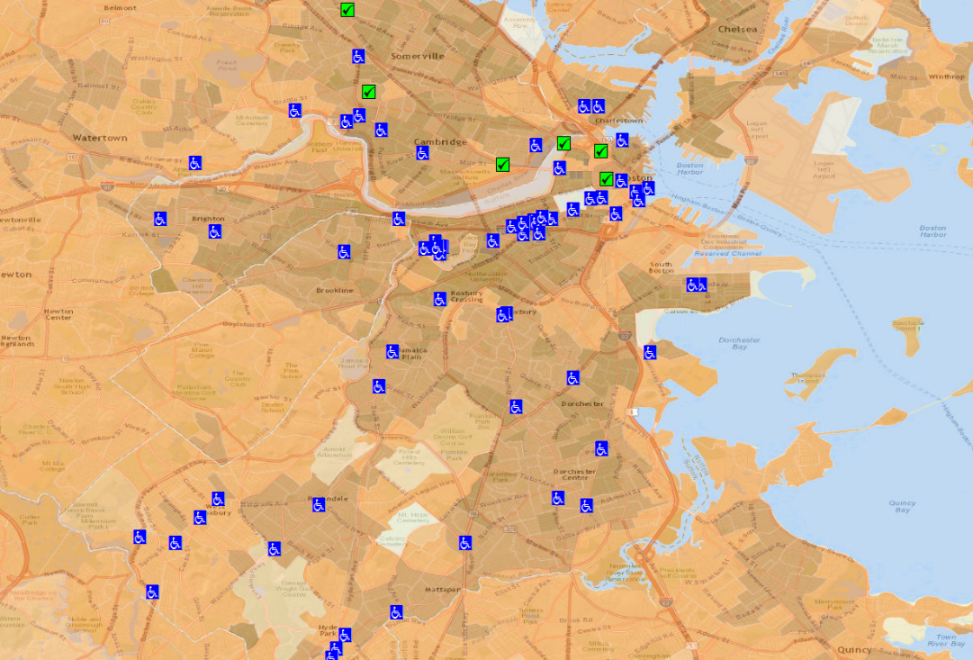
Mapping Insights
Restroom Availability vs. Population Density in Boston
Many densely populated areas do not have enough restrooms
Most public restrooms are confined on popular tourist circuits only, not useful for regular citizens

Slide 9
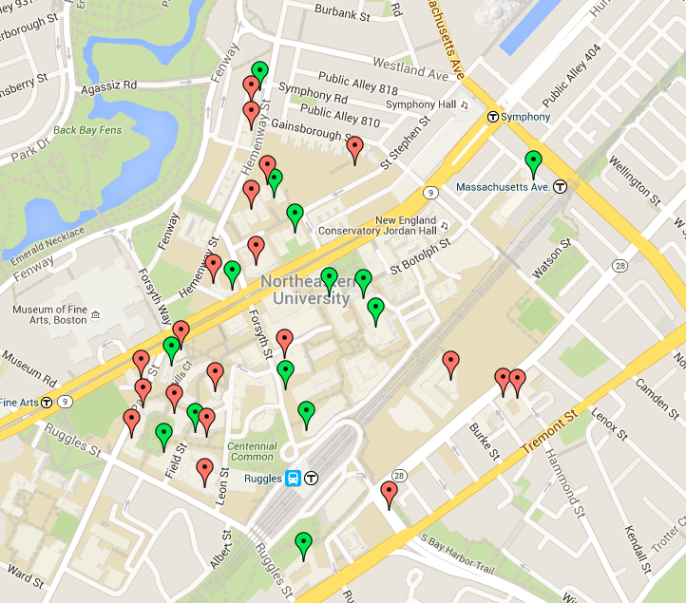
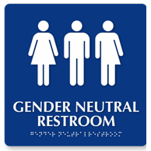
Mapping Insights
Gender Neutral Restrooms
Finding restroom is a challenge for Transgender population
No resource currently available which can help persons of different gender identities to locate restrooms.
Collected data for 77 locations across Boston from various sources (Fenway Health, NU LGBTQ Resource Center, Manual Survey)
The project aims to map gender neutral restrooms and have a separate layer.

Slide 10
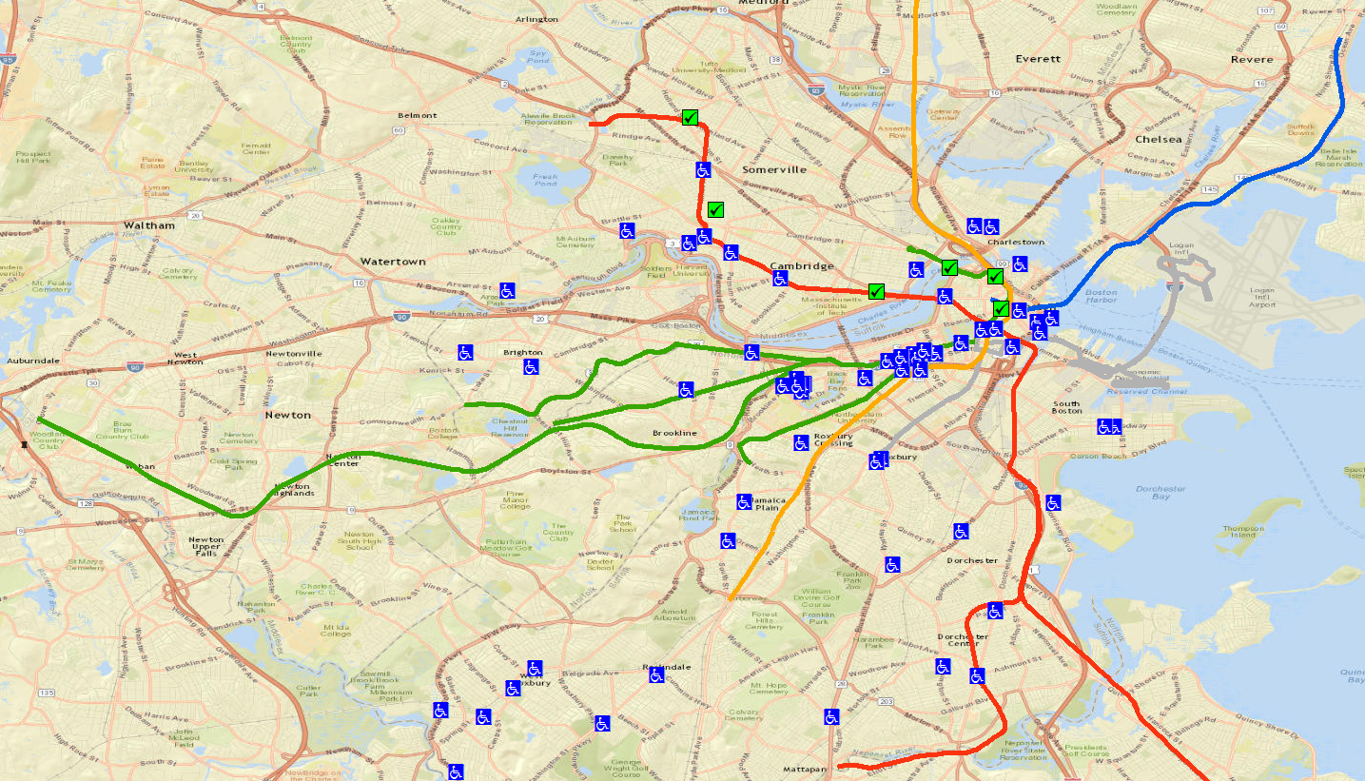
Mapping Insights
Lack of Restrooms near Transit Stations in Boston
Most MBTA stations do not have any public restrooms nearby.
MBTA stations which do have restrooms, they are inside the station area, which requires a ticket to get in
Lack of public restrooms alleviates the problems of the homeless, who mostly take shelter in the stations

Slide 11
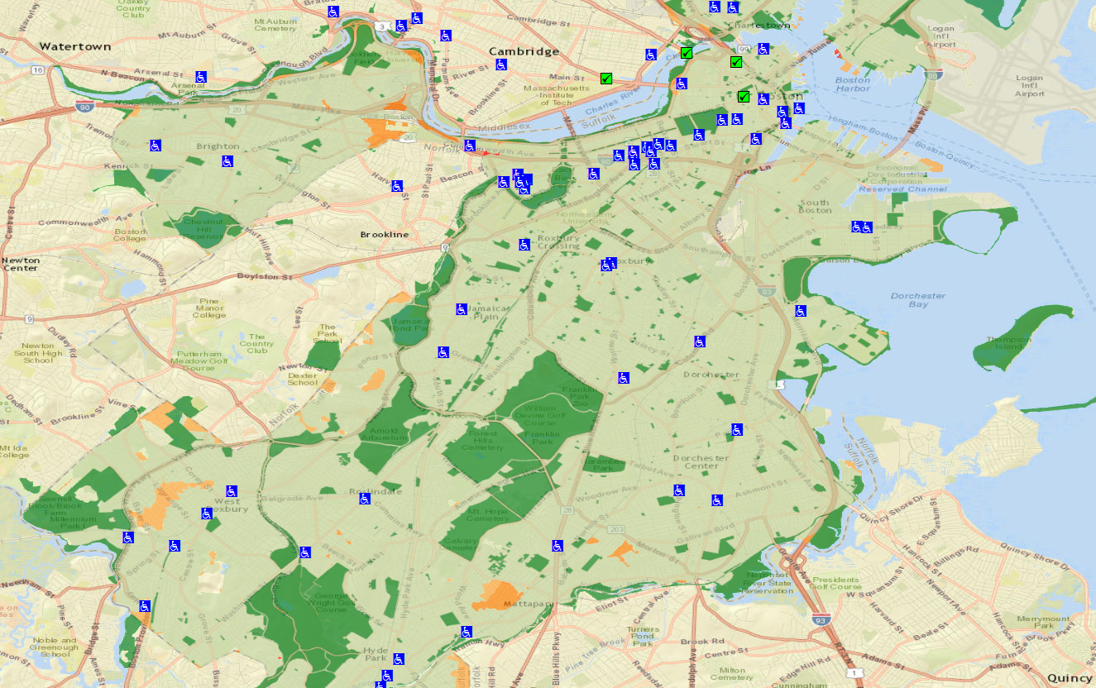
Mapping Insights
Lack of Restrooms near Public Parks
Most public parks in Boston lack any public restrooms nearby.
Surveys have repeatedly indicated that restroom availability and drinking water are the most important features missing
Problem for the elderly, women and children

Slide 12
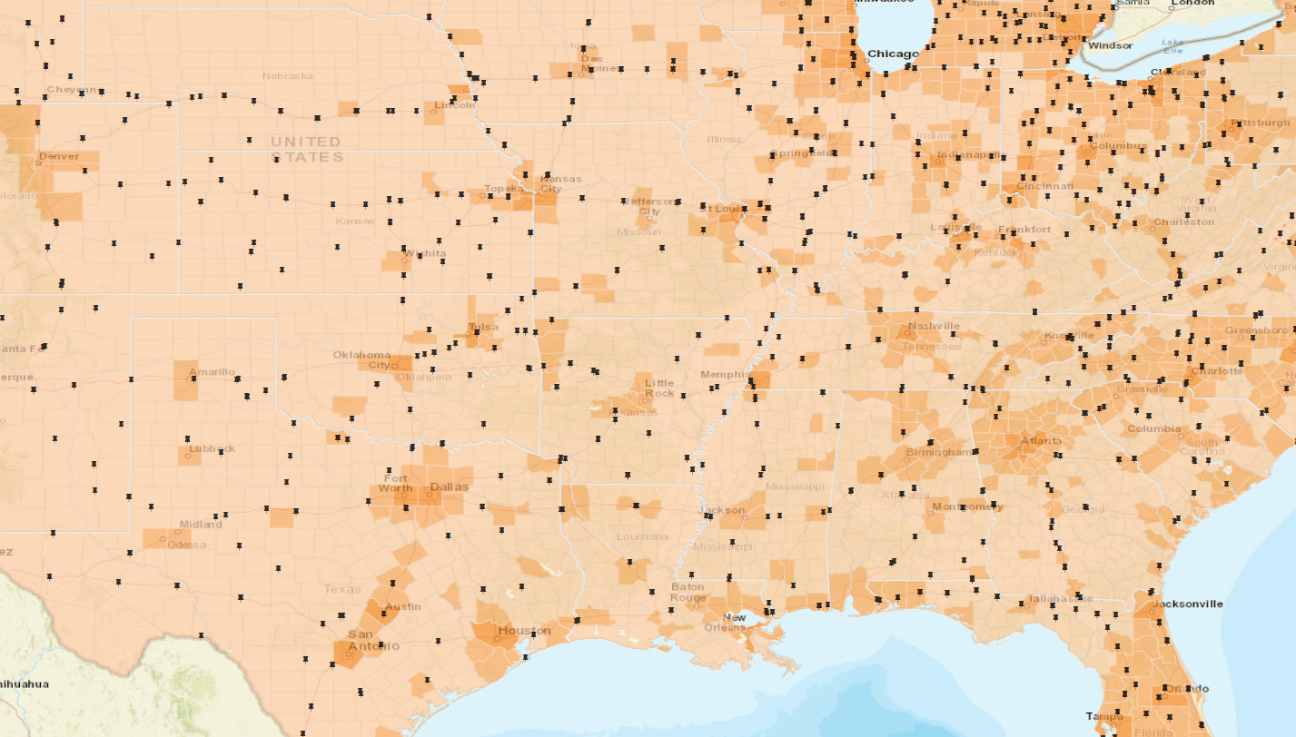
Mapping Insights
Restroom Availability vs. Population Density in US states
The availability of restrooms is very less in the central and southern states
Major cities and high population density areas have very few or no restrooms (USDOT)

Slide 13
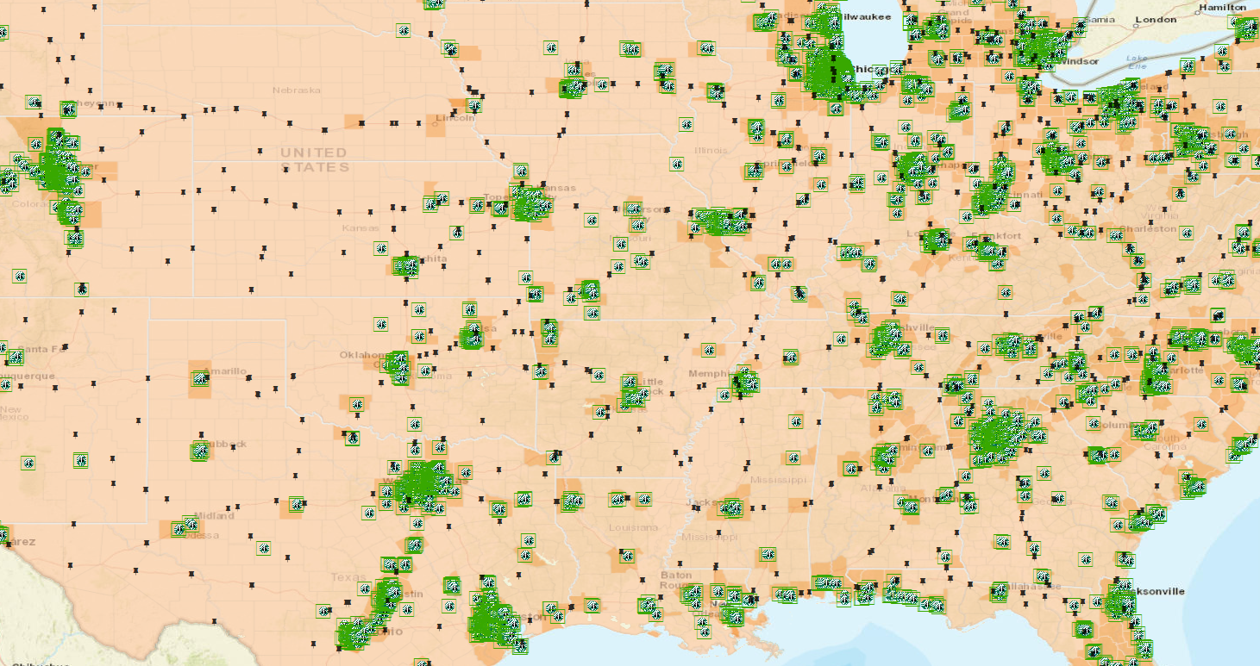
Mapping Insights
Restroom Availability vs. Population Density in US states
The availability of restrooms is very less in the central and southern states
Major cities and high population density areas have very few or no restrooms (USDOT)
The only option in the highly populated areas being paid/patron-only locations.

Slide 14
Future Enhancements
Add capability to include new restrooms using Collector Apps/APIs
Integrate into Mobile Application platforms (iOS, Android, Windows)
GPS Enabled search for nearest restroom based on current location
Condition Reporting for existing Restrooms using crowd sourced mapping platform
Project’s Mapping Service
Nearest Toilet Locator Phone App
iOS, Android & Windows Store Integration
Integrate Web GPS/Location services
Enable dynamic Crowd-mapping

Slide 15
References
Topic Research
Pharmacy Times: http://www.pharmacytimes.com/publications/issue/2005/2005-07/2005-07-9659
American Restroom Association: http://americanrestroom.org/locate/index.htm
Society of Urologic Nurses and Associates: https://www.suna.org/download/journal/article31106111.pdf
Occupational Safety and Health Administration: https://www.osha.gov/Publications/OSHA3795.pdf
World Toilet Summit: http://americanrestroom.org/gov/hhs/pr_call_action_110107.pdf
New York Times on Transgender Access to Restrooms: http://www.nytimes.com/2016/05/13/us/politics/obama-administration-to-issue-decree-on-transgender-access-to-school-restrooms.html?_r=0
Mapping Data
Universal Hub: http://www.universalhub.com/restrooms
Massachusetts Department of Transportation (MassDOT): https://www.massdot.state.ma.us/planning/Main/MapsDataandReports/Data/GISData/RestAreas.aspx
POI Factory: http://www.poi-factory.com/
U.S. Department of the Interior, U.S. Geological Survey: http://viewer.nationalmap.gov/launch/
Brookline Community Aging Network: http://brooklinecan.org/restrooms.html
US Rest Areas: http://restareas.appspot.com/
Salem GIS: http://www.salem.com/gis-and-maps
Mass GIS: http://www.mass.gov/anf/research-and-tech/it-serv-and-support/application-serv/office-of-geographic-information-massgis/

